Slide 1


Amazon Sales Analysis Report

Slide 2

Introduction
In the competitive e-commerce landscape, effective sales management is essential for reducing costs and increasing profits.
This project leverages Python and visualization tools to analyze Amazon sales data, uncovering trends and key metrics.
By examining monthly and yearly sales patterns, we aim to provide actionable insights into sales performance.
These insights will help drive strategic decisions and enhance overall business success.

Slide 3
Problem Statement
Sales management has gained importance due to increasing competition and the need for improved distribution methods to reduce costs and increase profits.
It is now the most important function in a commercial and business enterprise. Effective sales management not only drives revenue growth but also enhances customer satisfaction and loyalty.
By analyzing sales data, businesses can identify trends, optimize strategies, and make informed decisions to stay ahead in the market.

Slide 4
Project Objective
ETL Process: Extract, transform, and load an Amazon dataset.
Sales Trend Analysis: Identify sales trends month-wise, year-wise, and yearly-month-wise.
Key Metrics and Relationships: Determine key metrics and factors, and show meaningful relationships between attributes.

Slide 5
Key Metrics
Total Revenue:
$137.35 M
Total Profit:
$44.17 M
Unit Sold:
512871
Average Unit Price:
$276.76
Average Unit Cost:
$191.05

Slide 6
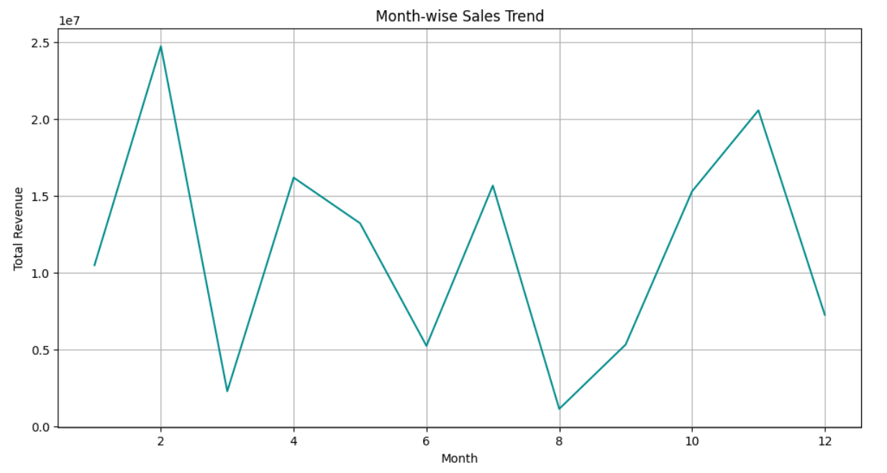
Visualizing Sales Trend: Month-Wise
Peak Sales:
February
November
Lowest Sales:
March
August
Sharp Increase:
Jan to Feb
Sharp decline:
Feb to Mar
Nov to Dec

Slide 7
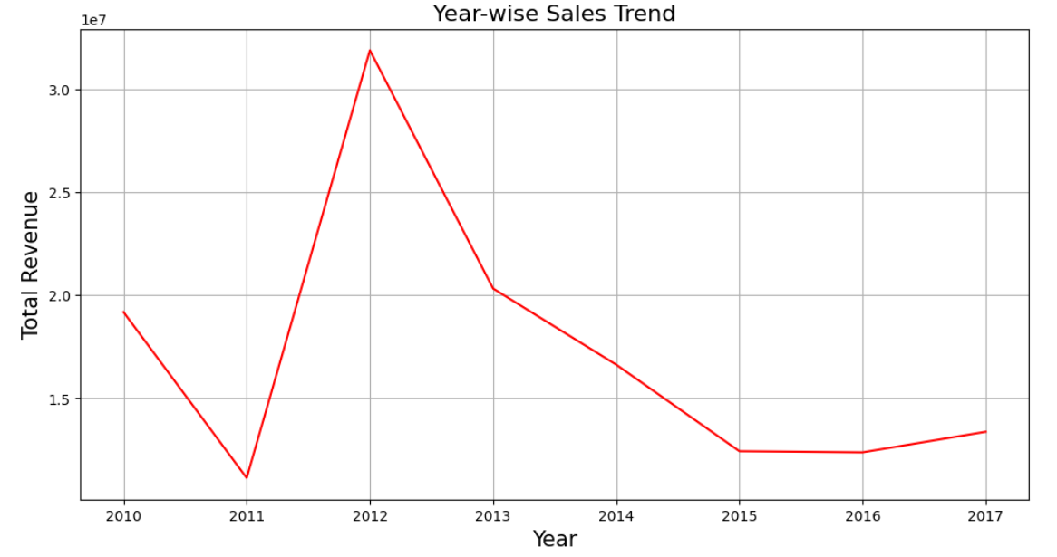
Visualizing Sales Trend: Year-Wise
Peak Sales Year:
2012
Lowest Sales Year:
2011
2016
2010-2011:
Decline
2011-2012:
Sharp increase

Slide 8
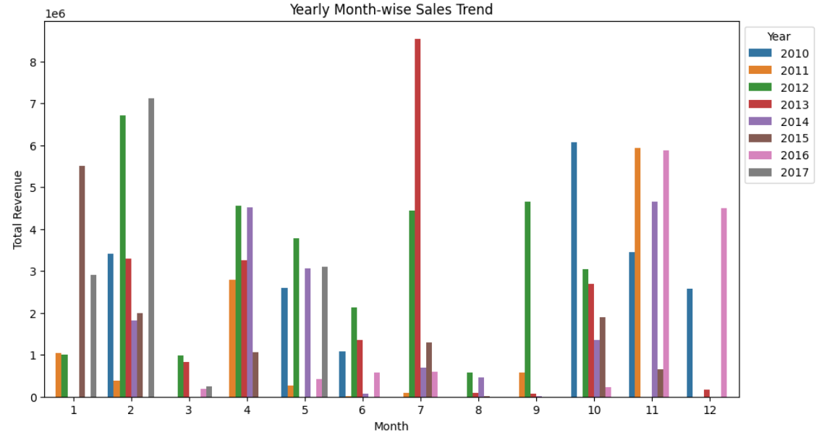
Visualizing Sales Trend: Yearly Month-Wise
High Sales Months: January, February, April, July, and October consistently show high sales across multiple years.
Low Sales Months: March, May, June, August, and September often have lower sales.
Notable Peaks: Specific years have unique peaks, such as October in 2010, April and December in 2011, February in 2012 and July in 2013.

Slide 9
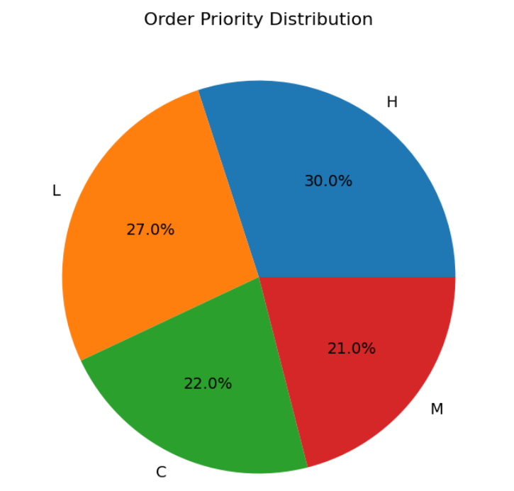
Visualizing Order Priority Distribution
The “Order Priority Distribution” pie chart shows:
High Priority (H): 30.0%
Low Priority (L): 27.0%
Critical ©: 22.0%
Medium (M): 21.0%

Slide 10
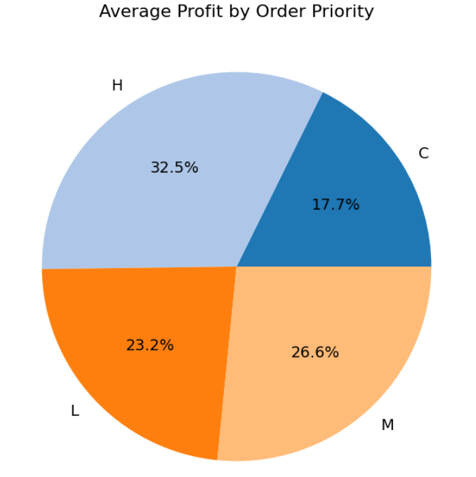
Average Profit by Order Priority
The “Average Profit by Order Priority” pie chart shows:
High Priority (H): 32.5%
Medium (M): 26.6%
Low Priority (L): 23.2%
Critical ©: 17.7%

Slide 11
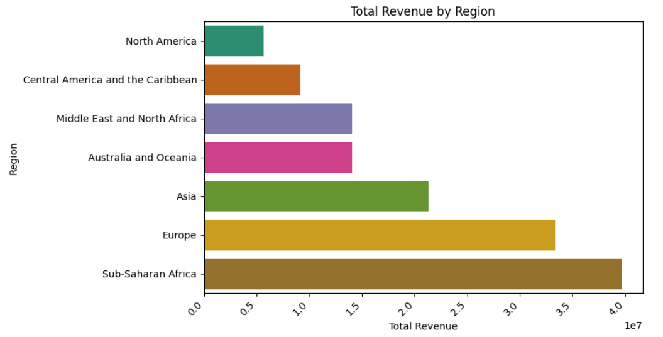
Total Revenue By Reason
Sub-Saharan Africa:
Generates the Highest revenue
Europe and Asia:
Generate Moderate amount of revenue
North America:
Generates Lowest Revenue

Slide 12
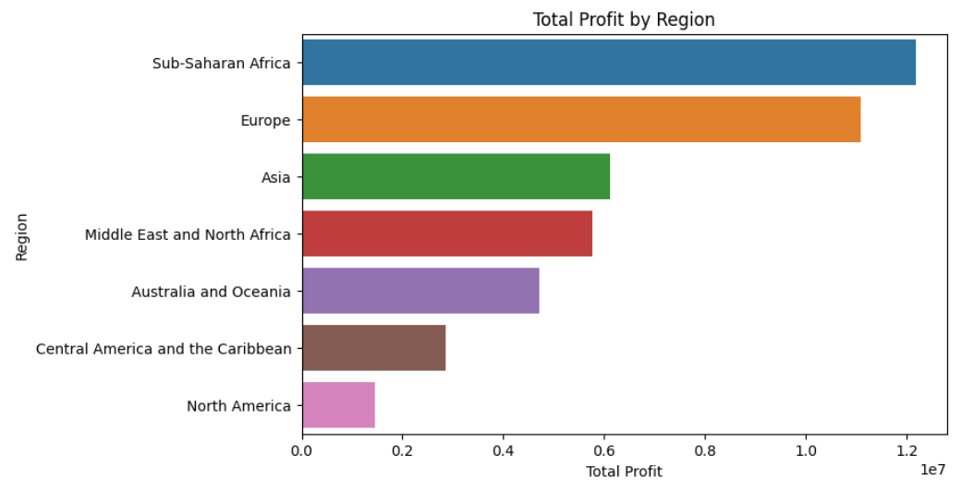
Total Profit By Region
Sub-Saharan Africa and Europe: Generates Highest Profit
Asia, Middle East and North Africa: Generate Moderate Profit
North America: Generates Lowest Profit

Slide 13
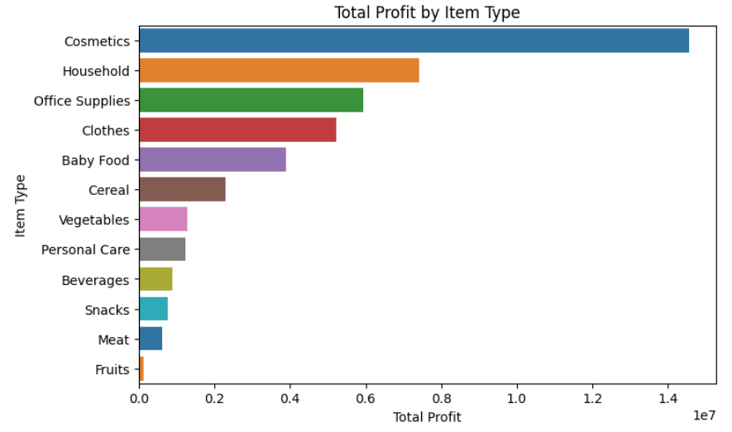
Total Profit by Item Type
Highest Profit:
Cosmetics
Next Highest:
Household items
Office Supplies
Significant Profits:
Clothes
Baby Food
Lowest Profits:
Fruits
Meat

Slide 14
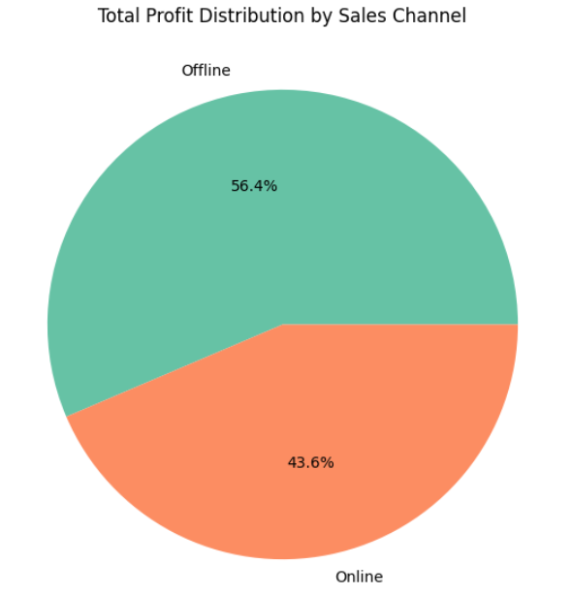
Total Profit Distribution by Sales Channel
Offline Sales:
56.4% of total profit
Online Sales:
43.6% of total profit
Offline sales are more profitable in this scenario.

Slide 15
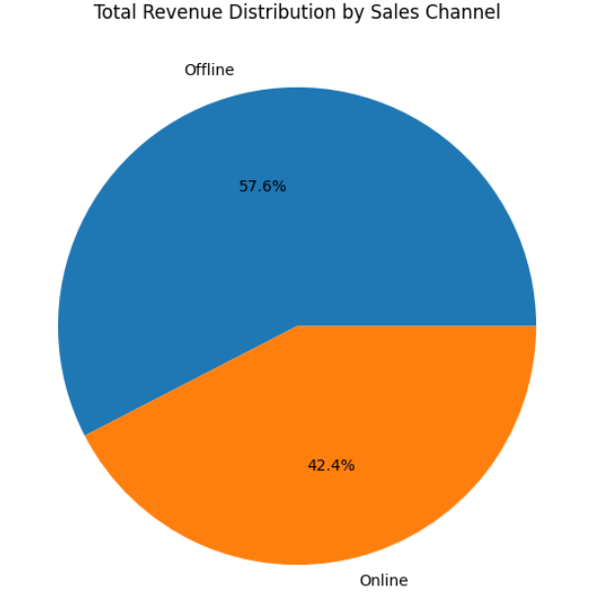
Total Revenue: Distribution by Sales Channel
Offline Sales:
57.6% of total revenue
Online Sales:
42.4% of total revenue
Offline sales are the dominant revenue source in this scenario.

Slide 16
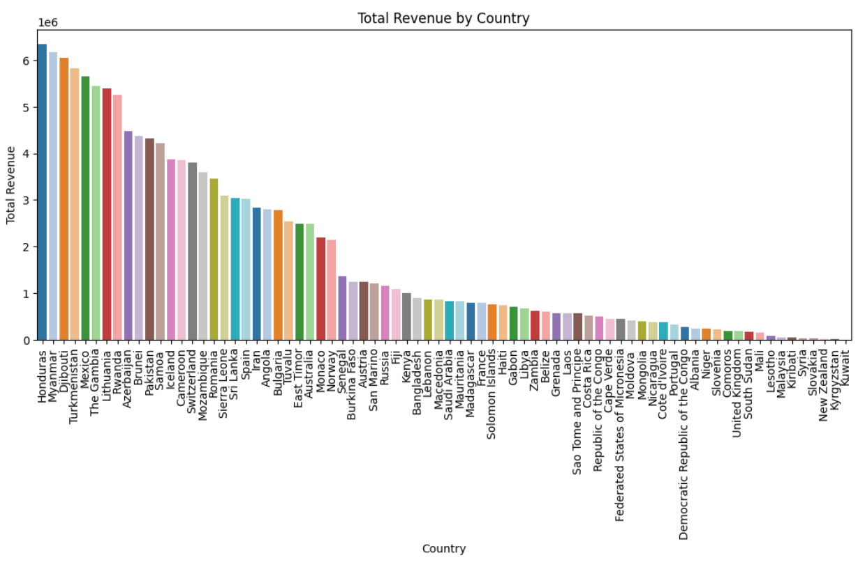
Total Revenue By Country
Highest Revenue:
Honduras
Lowest Revenue:
Kuwait
Top Five Countries:
Honduras
Myanmar
Djibouti
Turkmenistan
Mexico

Slide 17
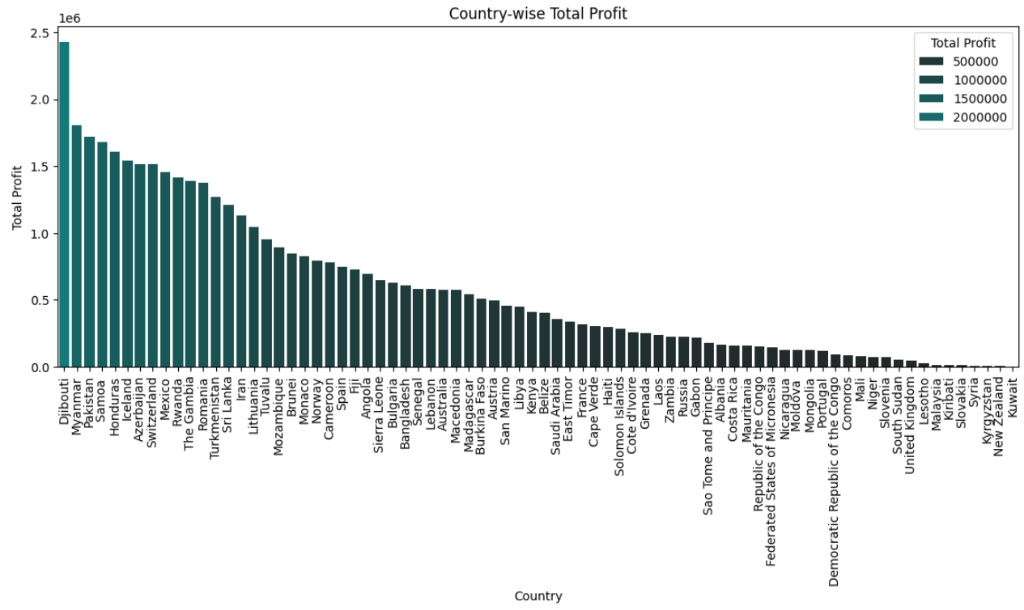
Total Profit by Country
Highest Revenue:
Djibouti
Lowest Revenue:
Kuwait
Top Five Countries:
Djibouti
Myanmar
Pakistan
Samoa
Honduras

Slide 18
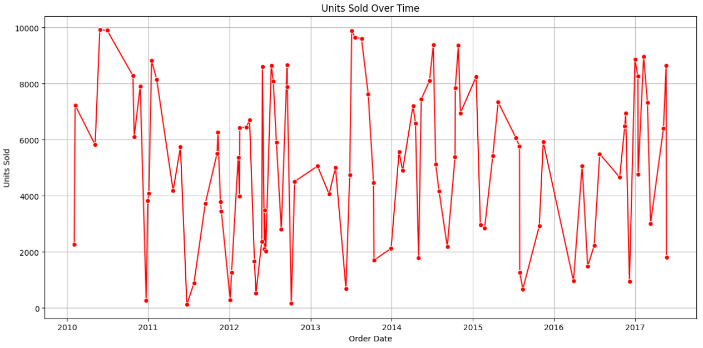
Unit Sold Over Time
2010-2011: High variability with peaks nearing 10,000 units.
2012: Drop in peak sales, fewer instances near 10,000 units.
2013: Increased volatility, highest peaks surpassing previous years.
2014-2015: Significant fluctuations, high peaks.
2016: Slight decrease in frequency and height of peak sales.
2017: Continued fluctuations, one of the highest spikes mid-year.

Slide 19
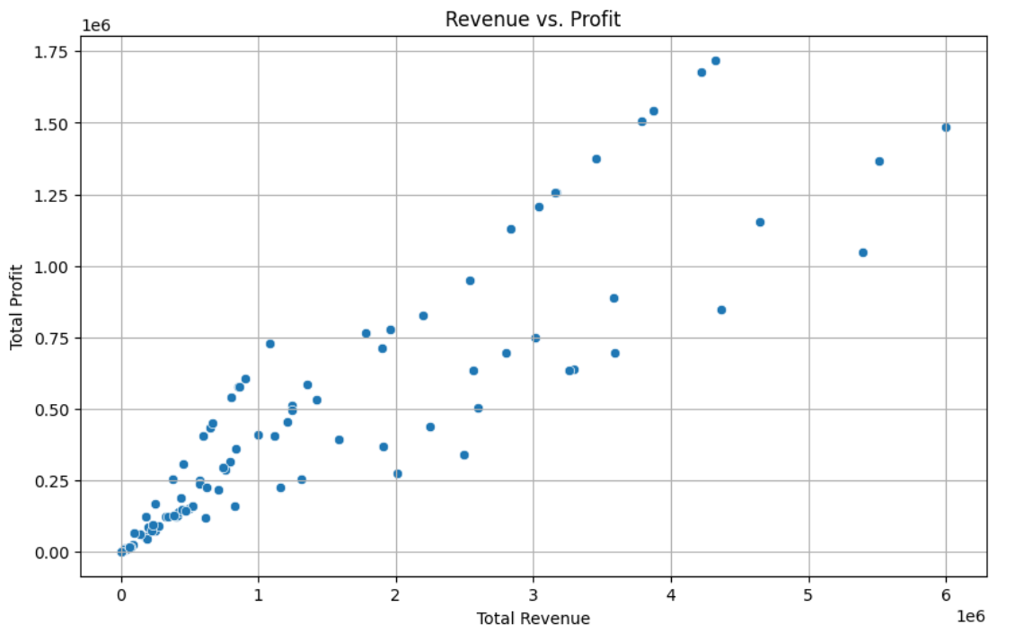
Relation Between Revenue and Profit
The scatter plot indicates a positive relationship between Total Revenue and Total Profit.
As Total Revenue increases, Total Profit also rises, shown by the upward trend of the data points.

Slide 20
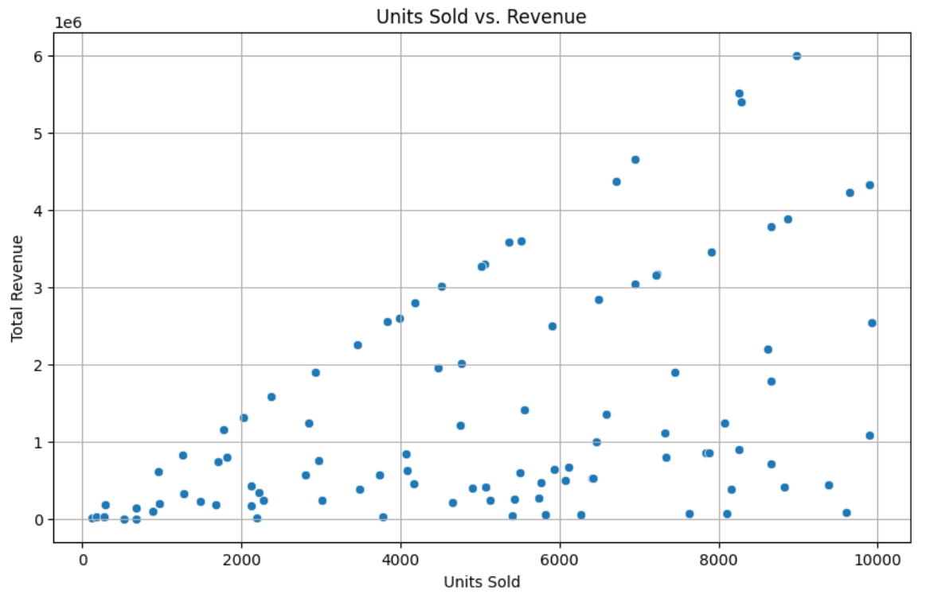
Relation Between Units Sold and Revenue
The scatter plot shows a positive relationship between Units Sold and Total Revenue.
Generally, more units sold lead to higher revenue, but some segments indicate bulk sales at lower prices.
No significant outliers are present.

Slide 21
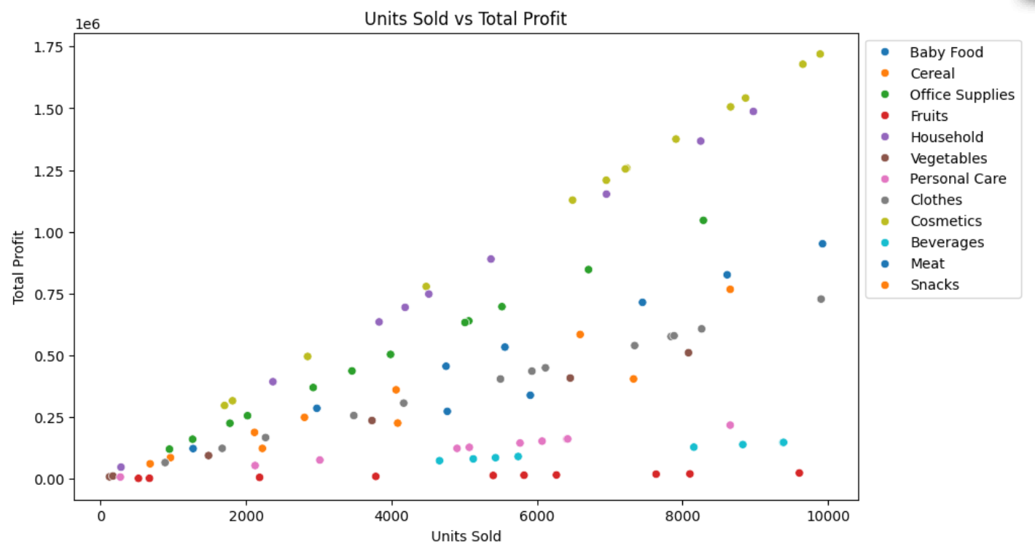
Relation Between Units Sold and Total Profit
The scatter plot shows a positive correlation between units sold and total profit.
Higher sales generally lead to higher profits.
Categories like ‘Clothes’ and ‘Cosmetics’ achieve high profits with fewer units sold, indicating higher profit margins.
‘Baby Food’, ‘Cereal’, and ‘Beverages’ show wide variability, while ‘Meat’ and ‘Snacks’ generate lower profits even at higher sales volumes.

Slide 22
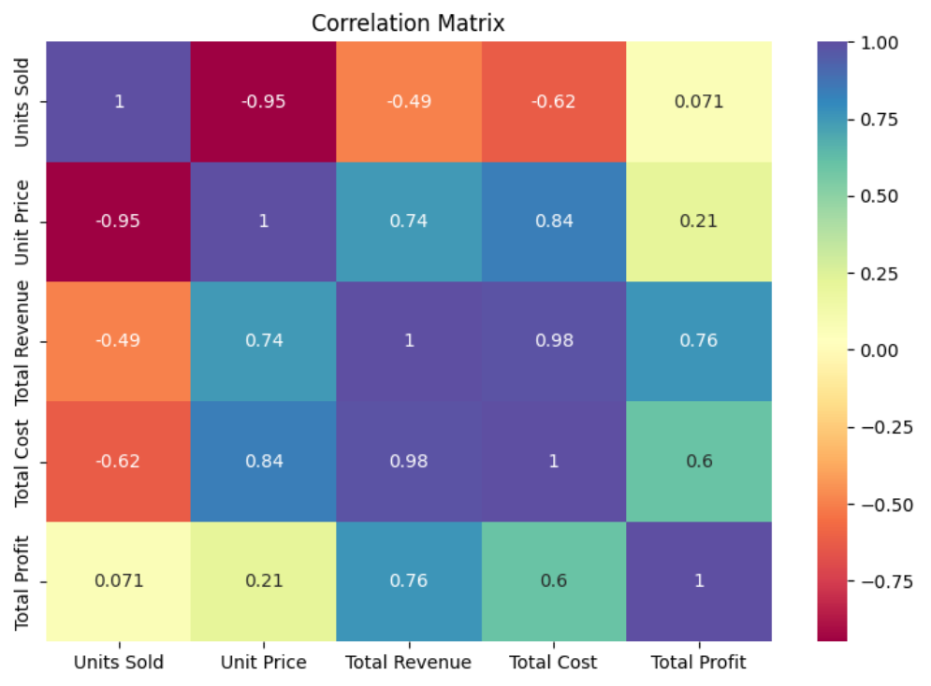
Visualizing Correlation Matrix of Numeric Columns
Units Sold & Unit Price:
Strong negative correlation (-0.95).
Total Revenue & Total Cost:
Very strong positive correlation (0.98).
Total Revenue & Total Profit:
Strong positive correlation (0.76).
Units Sold & Total Profit:
Moderate positive correlation (0.75).
Unit Price & Total Profit:
Moderate negative correlation (-0.75).
This highlights key relationships between sales, pricing, revenue, cost, and profit.

Slide 23
Conclusion
To drive Amazon's business growth, focus on optimizing inventory and marketing during peak sales months, and replicate successful strategies from past high-performing years like 2012.
Prioritizing high-margin, high-priority orders will enhance profitability.
Investing more in regions like Sub-Saharan Africa, while improving strategies in North America, will leverage regional strengths and address weaknesses.
Concentrating on profitable product lines such as cosmetics, and reassessing low-margin items like fruits and meat, will optimize the product mix.
Strengthening offline sales channels, which currently contribute significantly to revenue and profit, is crucial.

Slide 24
Conclusion
Leveraging positive correlations between key sales metrics will drive overall business growth and ensure Amazon's continued competitiveness and success.
Developing tailored strategies for top-performing countries like Honduras and Djibouti and addressing challenges in low-performing regions like Kuwait, will further enhance global performance.
Managing sales variability effectively, especially during high-variability years, will ensure stability.
Leveraging positive correlations between key sales metrics will drive overall business growth and ensure Amazon's continued competitiveness and success.

Slide 25

Thank You

